Slide 1
NRICH Conference:
Cambridge Maths Hub
19th April 2016
PRESENTED BY:
MRS CORDELIA MYERS,
LEAD TEACHER, CAMBRIDGE MATHS HUB

Slide 2
“No matter how well organised or detailed the curriculum, how grand or well resourced the building, what really matters most in a child’s education is the quality of the teaching. The challenge for the nation is to maintain a supply of outstanding teachers so that every child has the opportunity to be taught by inspirational, skilled teachers throughout their time in school.”
Carter Review of ITT

Slide 3
The Cambridge Maths Hub
Geetha Dorairaj, Projects Co-ordinator
Sue Southward , Comberton, one day a week
Katie Kendall, Caldecote, half a day a week
Cordelia Myers, Maths Hub Lead
Strategic Board, Operations Group

Slide 4
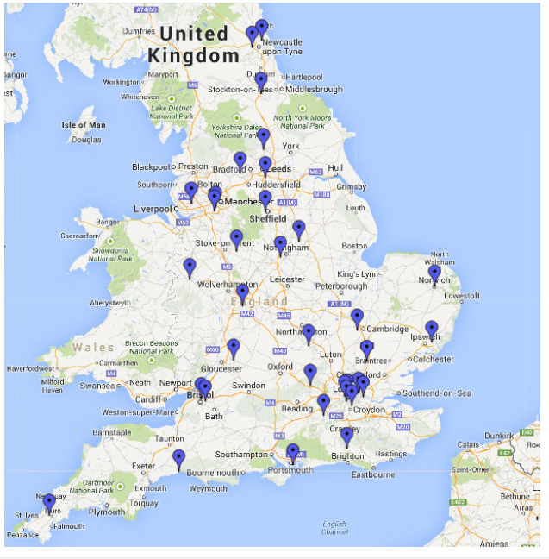
Maths Hubs across England

Slide 5
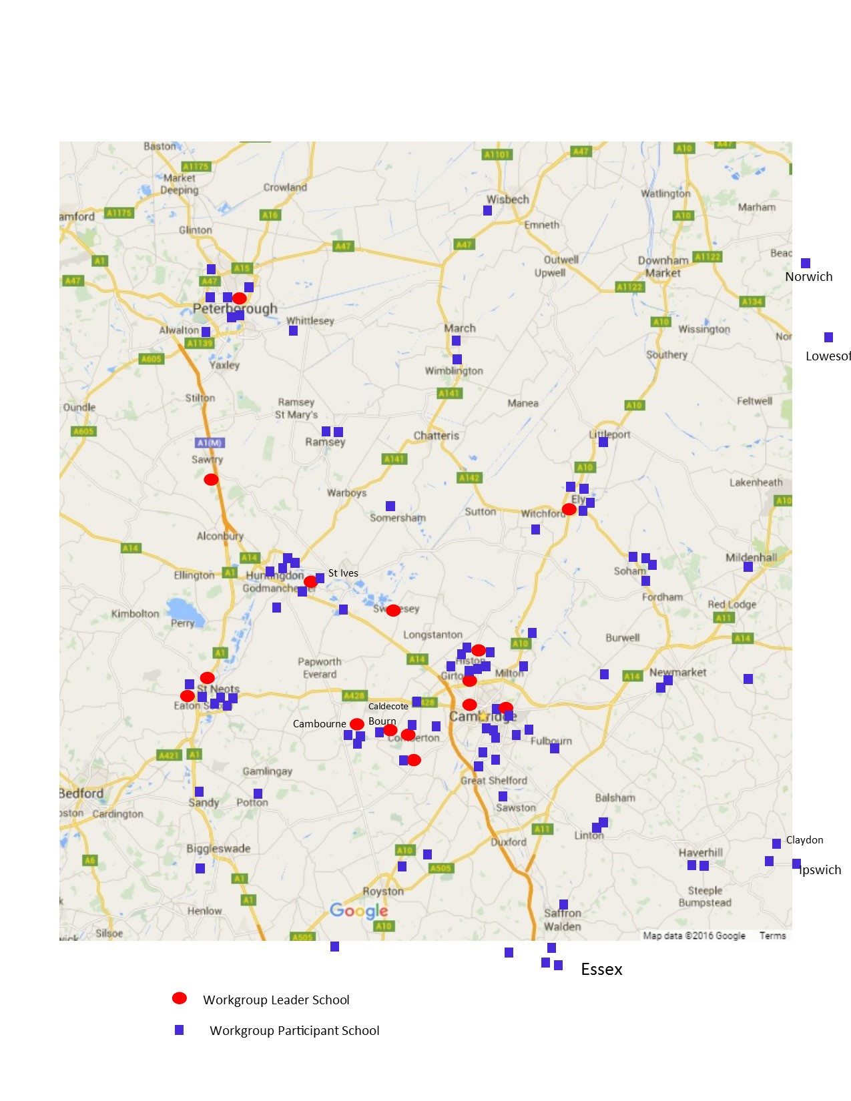

Slide 6
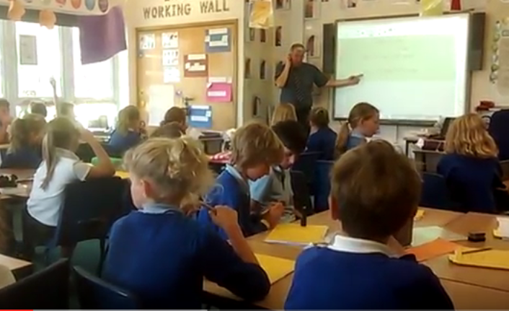
National Collaborative Projects
NCP 1a – England-China Education Research and Innovation Project (Shanghai Teacher Exchange-Primary)
John Canavan and
Sarah Wheatman

Slide 7
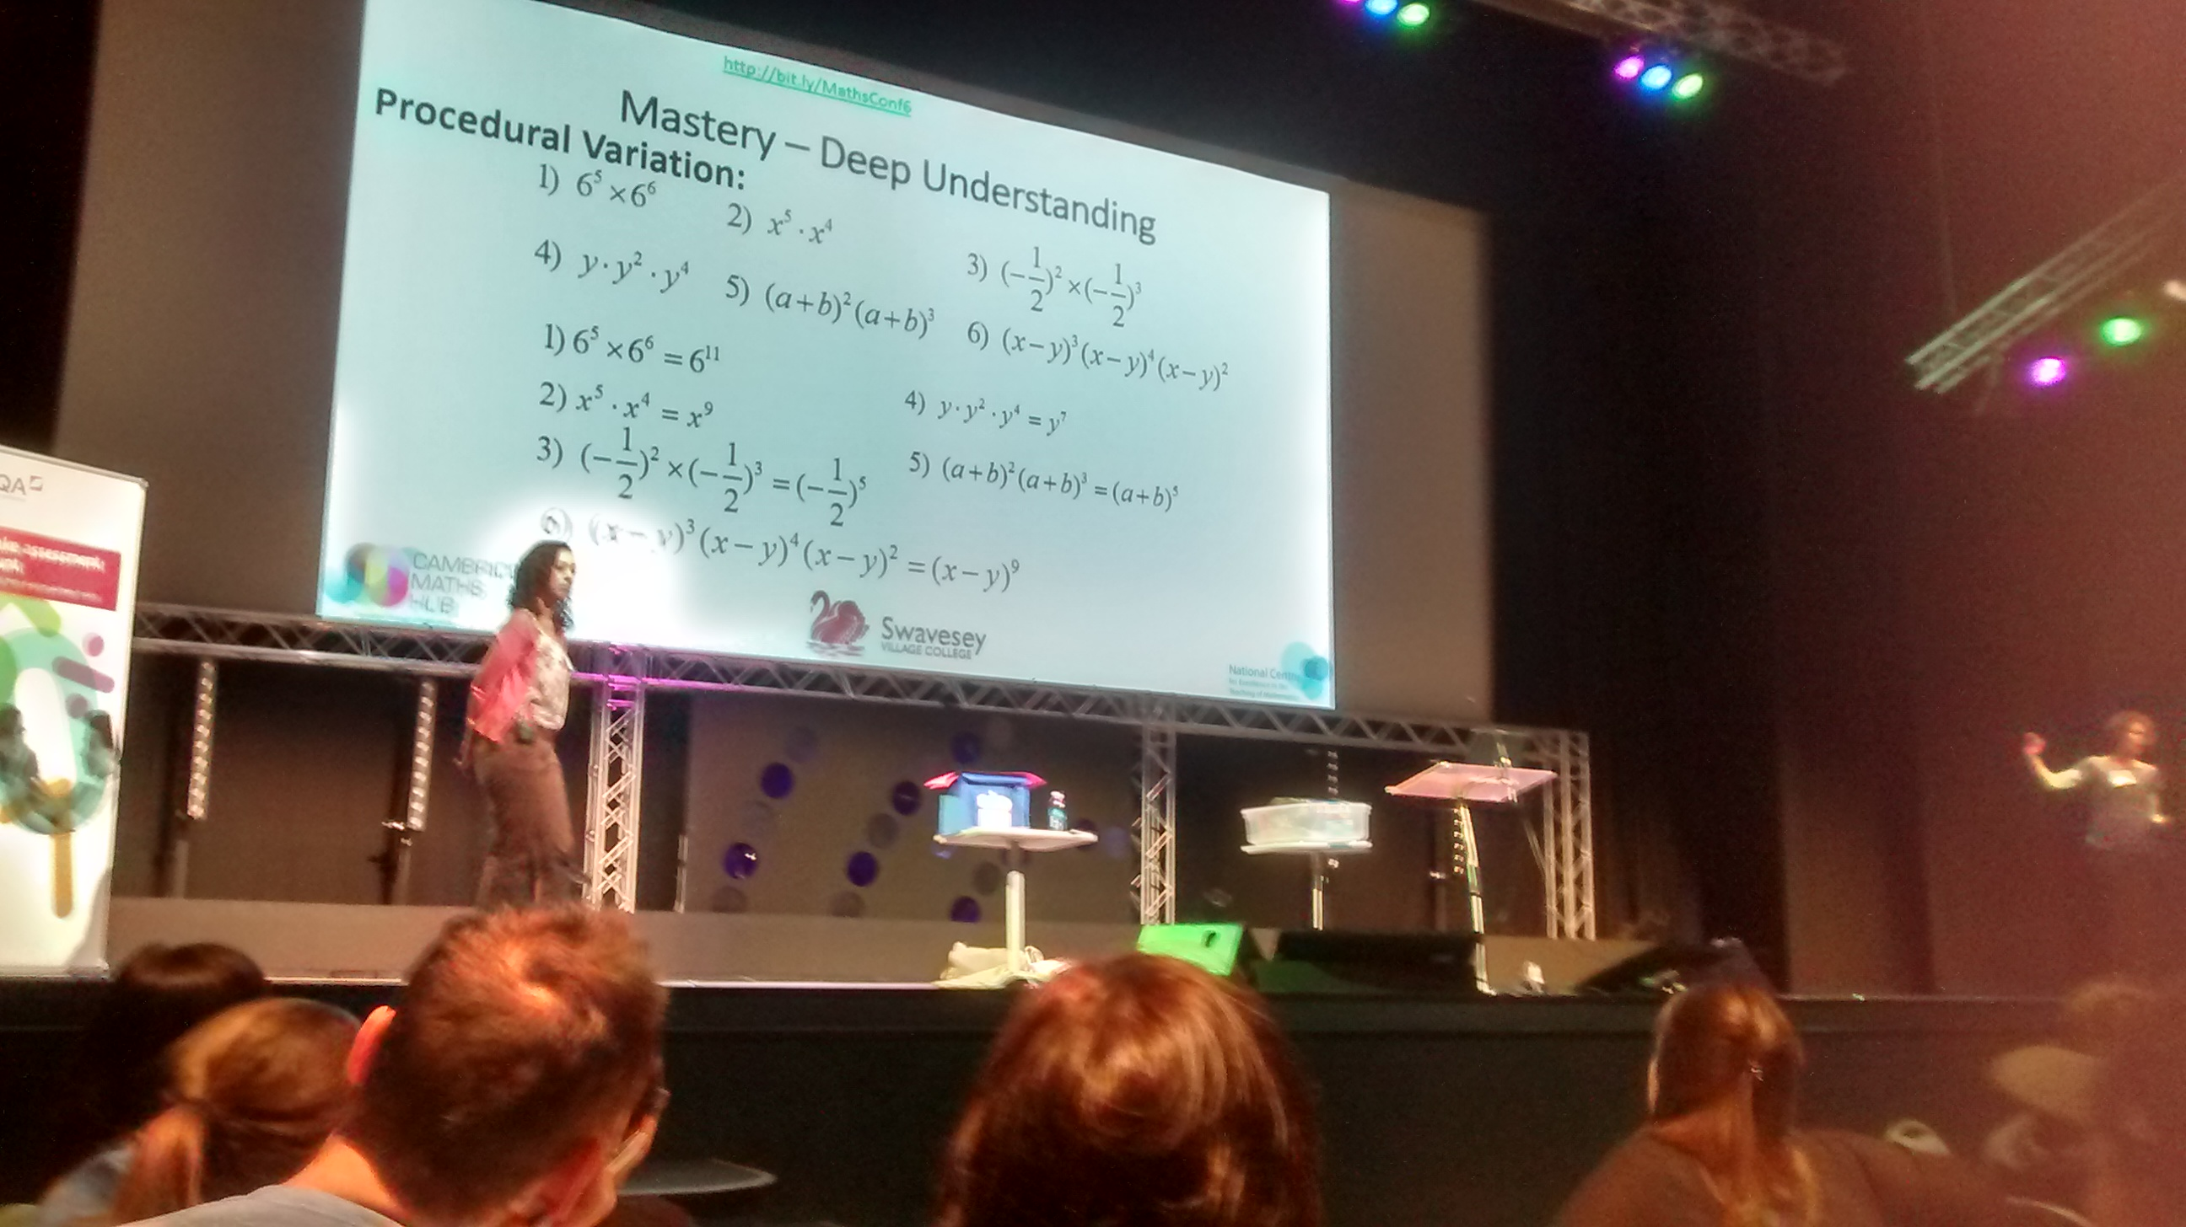
National Collaborative Projects
NCP 1b: England-China Education Research and Innovation Project (Shanghai Teacher Exchange – lower secondary (Y7 & 8))
Charmayne Bailey and Cameron Fehr from Swavesey VC

Slide 8

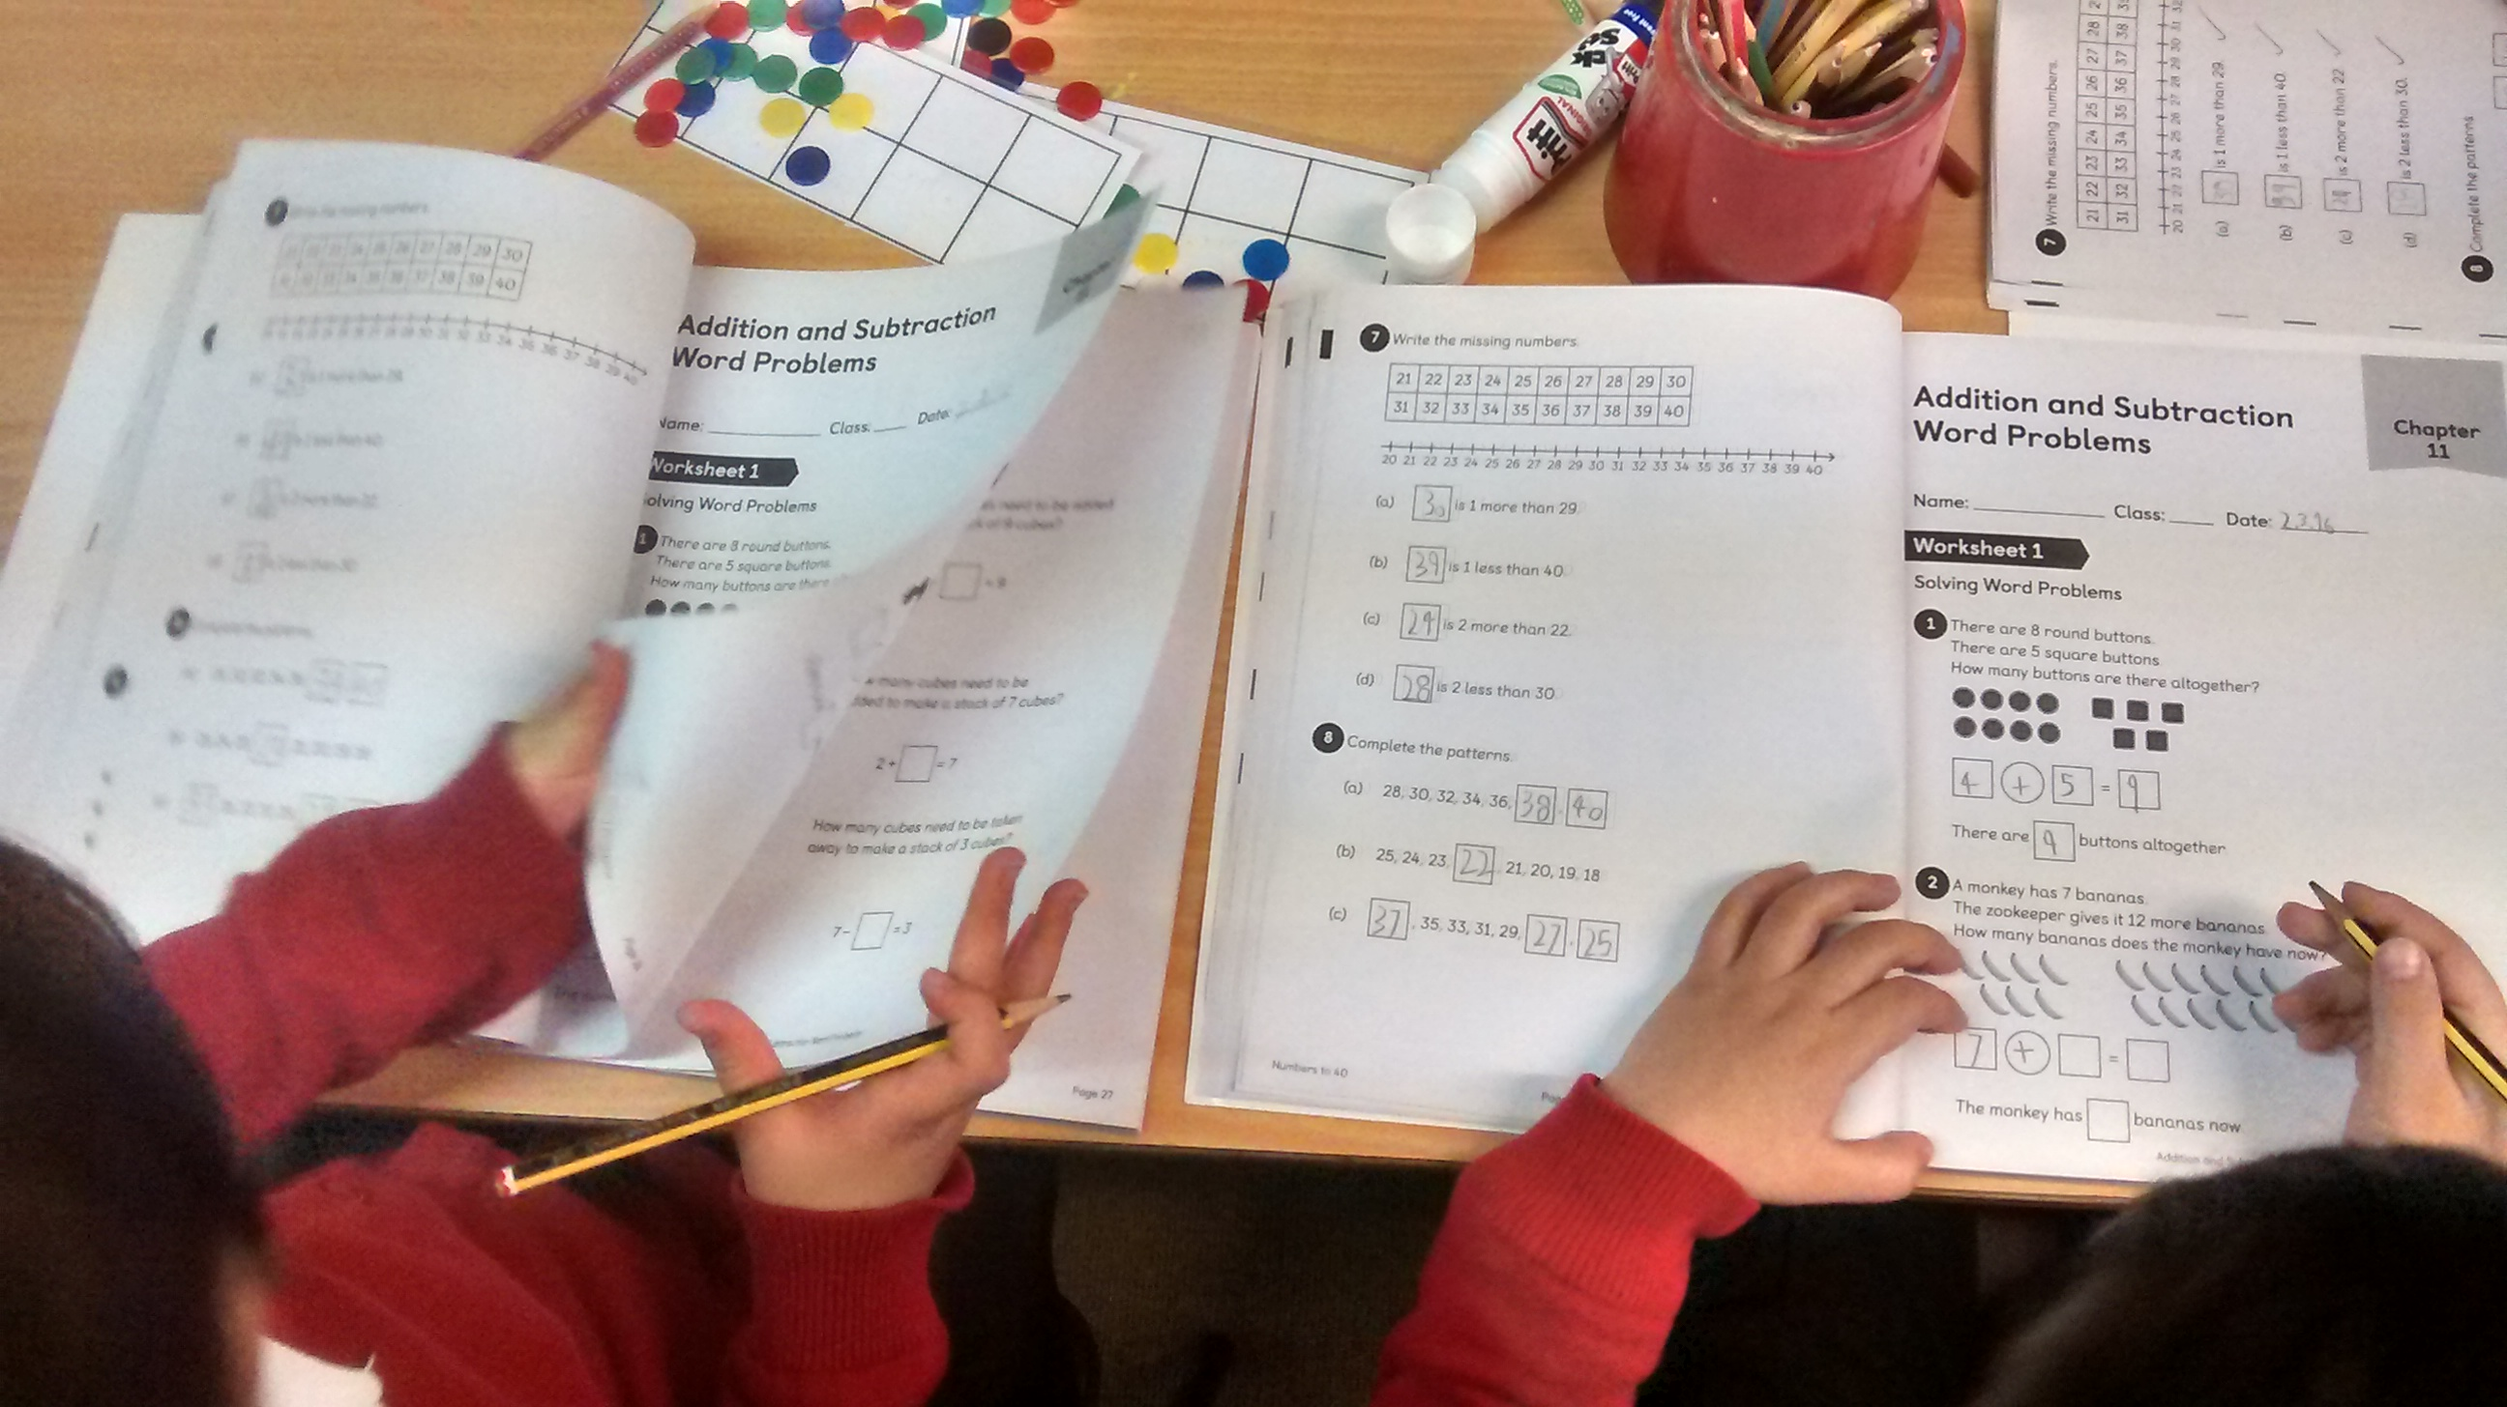
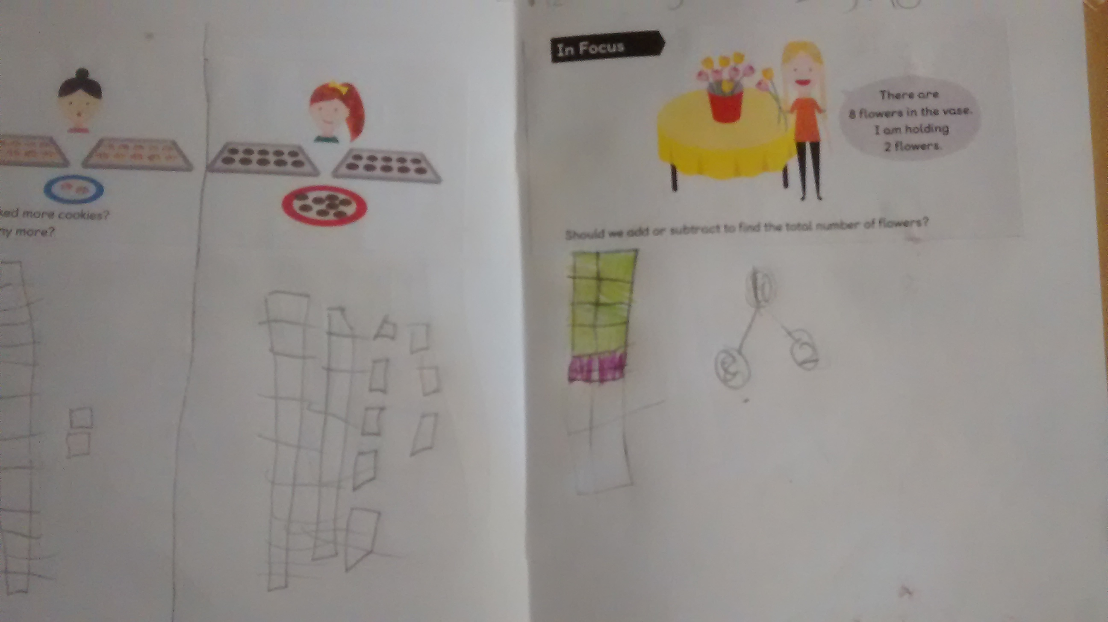
National Collaborative Projects
NCP2: Use of high quality textbooks (linked to Singapore) to support teacher professional development and deep conceptual and procedural knowledge for pupils
Caldecote, Spinney and Buckden

Slide 9

National Collaborative Projects
NCP3: Increasing participation in level 3 maths post-16
Next week a group of post 16 teachers will be gathering to look at ways of increasing participation in Maths.
Lily Tang, Kristin Coldwell and Jamie Freeman will be leading.
21st April 1 – 4 pm Cambourne VC
Free lunch!

Slide 10
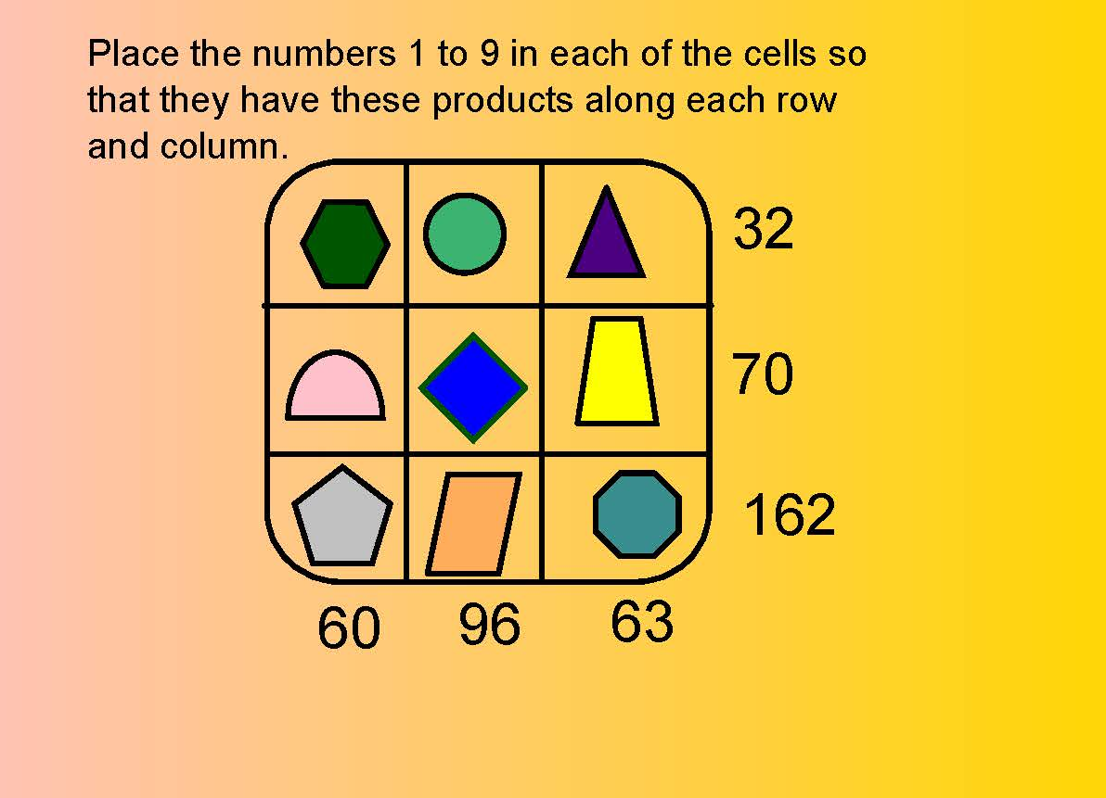
National Collaborative Projects
NCP4: KS3 Reasoning: Cambourne, Comberton, St Bedes, Thomas Deacon, Ormiston Bushfield, Voyager
Reasoning is a major focus of the new national curriculum. CMH is trying to promote use of reasoning and support teachers in delivering tasks that encourage students to think rather than repeat.

Slide 11
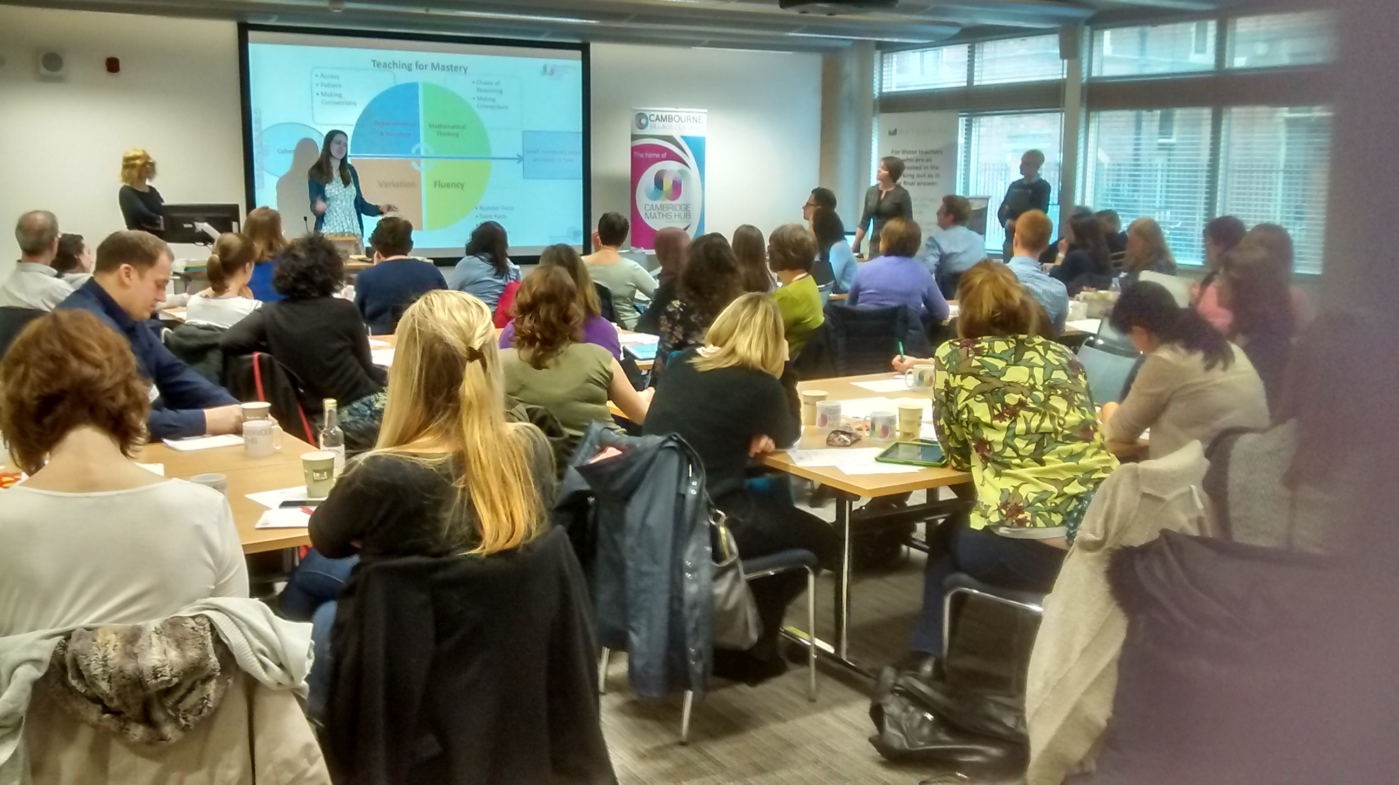
National Collaborative Projects
NCP 5: Teaching Maths for Mastery: Thorndown, University Primary School, Mayfield, Eynesbury plus 14 TRG schools
“Mastery” is seen as factual knowledge combined with conceptual understanding and procedural fluency.
This results in confident, secure and flexible learners. They are able to connect ideas and apply their understanding.

Slide 12
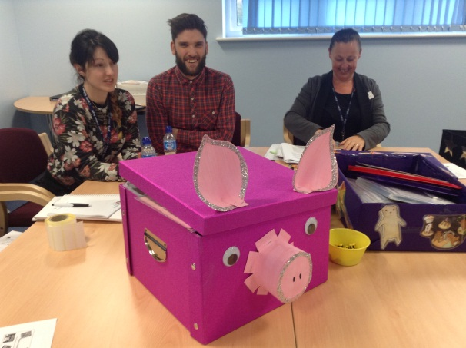
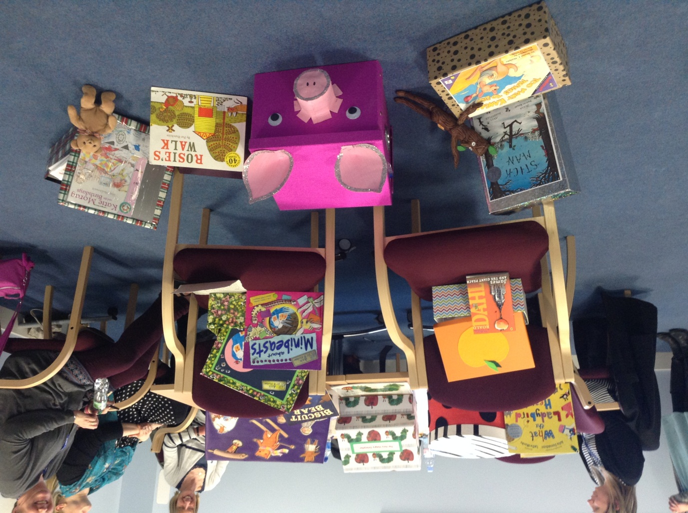
Primary Workgroups: Maths in Stories

Slide 13
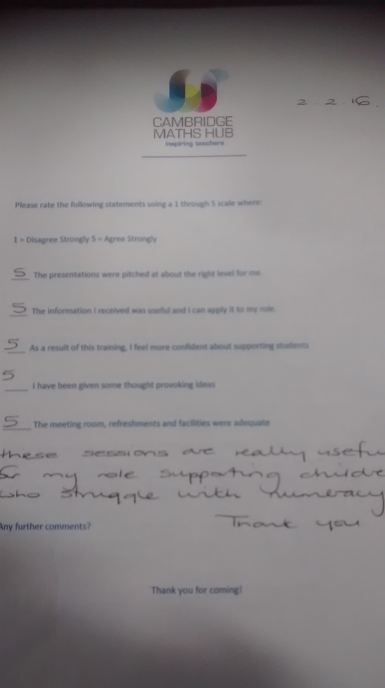
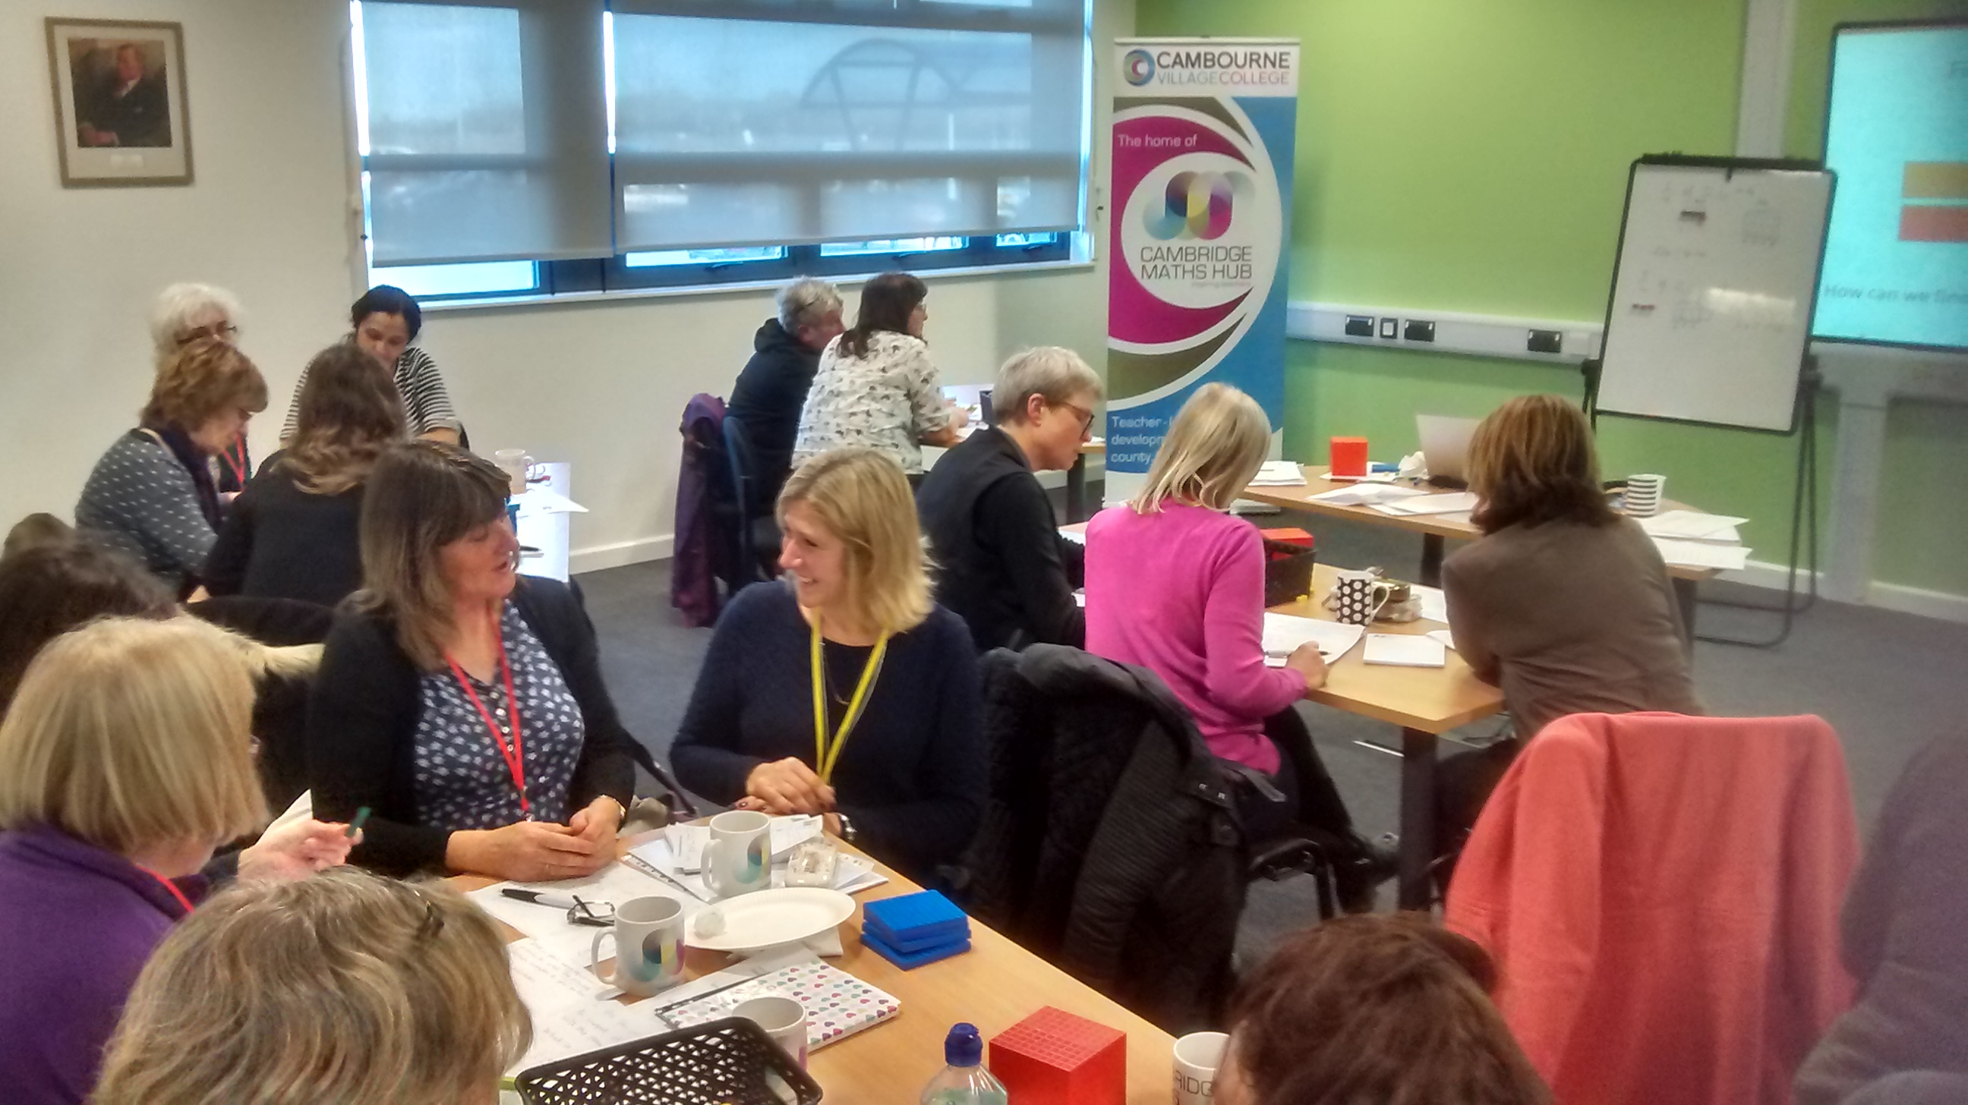
Primary Workgroups: TA training

Slide 14
Lesson Study
Many have credited the steady improvement of Japanese elementary mathematics and science instruction to their teachers undertaking ‘lesson study’. This is a process in which teachers jointly plan, observe, analyse and refine actual classroom lessons, called ‘research lessons’.
Lesson Study: Enhancing Mathematics Teaching and Learning
By David Burghes CIMT (Centre for Innovation in Mathematics Teaching) University of Plymouth
Derek Robinson Bishop Luffa School, Chichester

Slide 15
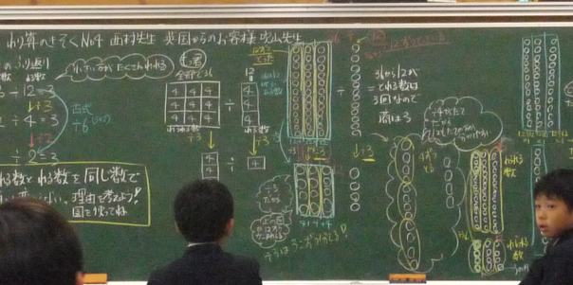
Children’s misconceptions manifested themselves at various points during this lesson, but they stuck with it, trying out explanations and diagrams and grappling with the proportions involved, always confident their ideas would be taken seriously and discussed.
Fully funded PD opportunity available: Deadline 26th April

Slide 16

Mastery day conference with Debbie Morgan
3rd or 10th October 2016
Put a note on your evaluation form if you would like us to email you

Slide 17
ICCAMS project
An intervention project showing phenomenal progress for students in the pilot study
110 schools with 5 from CMH to work on this KS3 project for 2 years
2 lessons and 2 short assessments per month
Either a control school (£1500) or an active school (free quality PD and resources)

Slide 18

Interested in developing your leadership skills?
Here are some opportunities:
Asst Hub Lead based in Peterborough (Perm)
10% Secondment to the Maths Hub (temp)
NCETM Primary PD lead accreditation
MaST training

Slide 19
So what is an NRICH Lead? Our vision is twofold: To have numerous NRICH work groups happening across the county and in Peterborough. We also hope to run more conferences like today, with your support and contributions. On June 20th we will be having a meeting for all potential work group leaders. Let us know if you would like to be involved. The CMH will pay for your time and expenses.
YOU

Slide 20
Plans for next year:
Primary
Primary Shanghai
Knowledge Quartet
Mastery TRGs (4)
Maths in stories
Nrich (you)
Singapore text book training
Ratio and proportion in Year 6
Mastery for struggling learners
Calculate, don’t count
Stretching the quick learners
Lesson study
Secondary and post 16
KS3 Reasoning
Aspiring Leaders
NRICH (you)
Multiplicative reasoning
Core Maths Pedagogy Development
Geogebra
Increasing Participation at Post 16
Shanghai Secondary
Lesson Study

Slide 21
Ems Lord, NRICH director
wild.maths.org

Slide 22
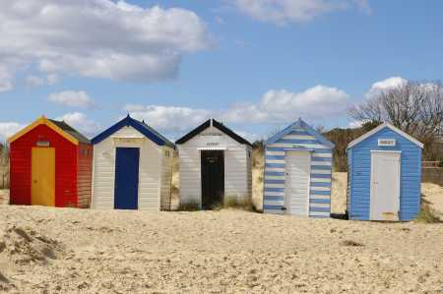

Slide 23
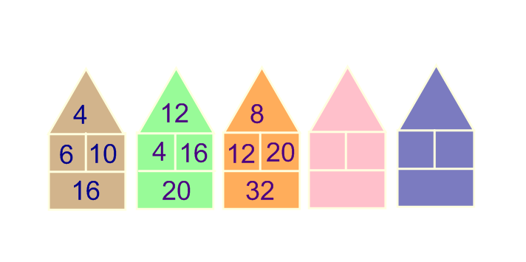
Beach huts
with thanks to nrich.co.uk/11008

Slide 24
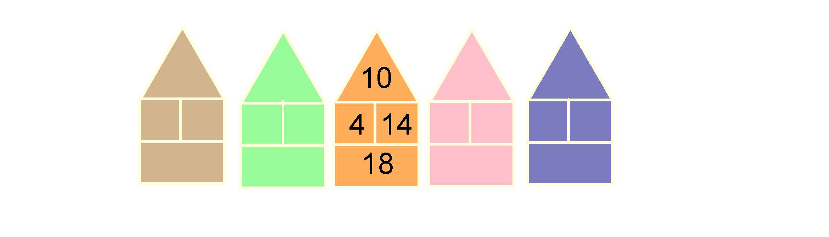
Beach huts
with thanks to nrich.co.uk

Slide 25

Beach huts
with thanks to nrich.co.uk

Slide 26
“No matter how well organised or detailed the curriculum, how grand or well resourced the building, what really matters most in a child’s education is the quality of the teaching. The challenge for the nation is to maintain a supply of outstanding teachers so that every child has the opportunity to be taught by inspirational, skilled teachers throughout their time in school.”
Carter Review of ITT

Slide 27
What next?
Share what you have learnt within your own school
Consider sharing what you have learnt with other schools….
………if you would like the Hub to sponsor this please let us know by email or on your evaluation form
…….join us leading NRICH conferences
Express interest in a work group - they are all free.
27

Slide 28
Plans for next year:
Primary
Primary Shanghai
Knowledge Quartet
Mastery TRGs (4)
Maths in stories
Nrich (you)
Singapore text book training
Ratio and proportion in Year 6
Mastery for struggling learners
Calculate, don’t count
Stretching the quick learners
Lesson study
Secondary and post 16
KS3 Reasoning
Aspiring Leaders
NRICH (you)
Multiplicative reasoning
Core Maths Pedagogy Development
Geogebra
Increasing Participation at Post 16
Shanghai Secondary
Lesson Study

Slide 29
Please fill in your evaluation form.
Thank you for coming today. Safe journeying…Keep in touch.
29

